Slide 1
The HTTP Protocol

Slide 2
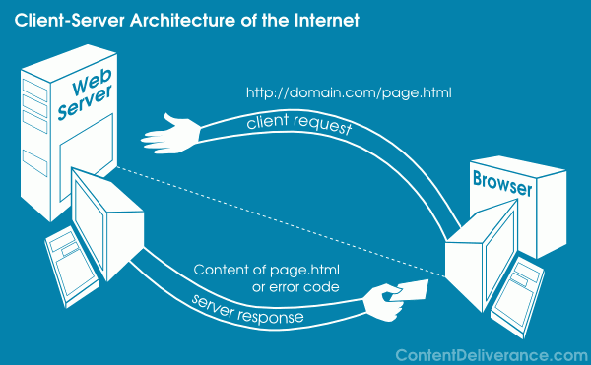
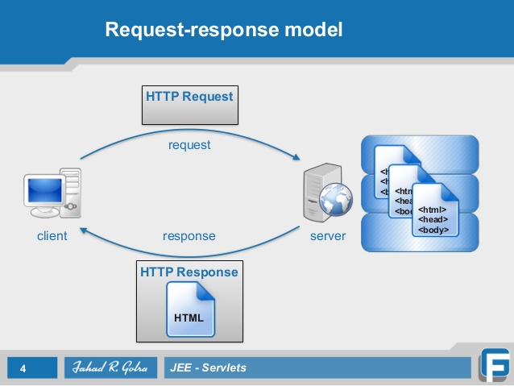
Hypertext Transfer Protocol
The HTTP is an Application layer protocol that allows web application to communicate and exchange data.
Client – server based Architecture.
Request – Response model.

Slide 3
Three Important things about the HTTP
The HTTP is Connectionless protocol (1.0 without connection keep alive) – after making the request the client disconnect from the server, then when the response is ready the server re-establish the connection again and deliver the response.
A connectionless protocol describes the communication between two network end points where a message is sent from one end point to another without a prior arrangement. At one end, the device transmits data to the other before ensuring that the device on the other end is ready to use.
The HTTP can deliver any sort of data, as long as the two computers are able to read it.
The HTTP is a Stateless protocol.

Slide 4
HTTP Session
Client send request
Server listen to client requests
After receiving a request, server sends a status line and the message
HTTP/1.0
Separate Connection to same server for every resource connection
High Latency
HTTP/1.1
The commonly used version today
Can reuse connection multiple times to download resources
Low Latency

Slide 5
HTTP/1.0
Building extensibility
Browser-friendly protocol
Provided header fields including rich metadata about both request and response (HTTP version number, status code, content type)
Response: not limited to hypertext (Content-Type header provided ability to transmit files other than plain HTML files — e.g. scripts, stylesheets, media)
Methods supported: GET , HEAD , POST
Connection nature: terminated immediately after the response
HTTP/1.1 — The standardized protocol
This is the HTTP version currently in common use.
Introduced critical performance optimizations and feature enhancements — persistent and pipelined connections, chunked transfers, compression/decompression, content negotiations, virtual hosting (a server with a single IP Address hosting multiple domains), faster response and great bandwidth savings by adding cache support.
Methods supported: GET , HEAD , POST , PUT , DELETE , TRACE , OPTIONS
Connection nature: long-lived

Slide 6
HTTP Methods
GET
HEAD
.
POST
PUT

Slide 7
DELETE
Deletes a specified resource
TRACE
•Echoes back a received request
•Clients can see the changes made to the request by intermediate servers.
OPTIONS
Returns set of HTTP methods which server supports for the specified URL

Slide 8
HTTP Message
A typical HTTP Message
Start Line
Contain plain text based information
Headers
Body

Slide 9
Request HTTP message
Response HTTP Message
Start Line
Method path/to/file.ext http/version
http/version Status Code
Name1: value1
Name2: value2
Name3: value3
Name1: value1
Name2: value2
Name3: value3
Headers
Differs from
Eg:-
Eg:- File Requested
Body

Slide 10
Example for Request HTTP message
Method
URL
HTTP Version
Start Line
GET /product/myproduct.html HTTP/1.0
The method is a command that tells the server to what to do
Headers
Host : www.mywebsite.com
Accept : text / html
Aceept-language : en - US

Slide 11
Example for Response HTTP message
HTTP Version
HTTP/1.0 200:OK
IT tells the client if the request succeeded or failed
Host : www.mywebsite.com
Accept : text / html
Aceept-language : en - US
Products/myproducts.html

Slide 13
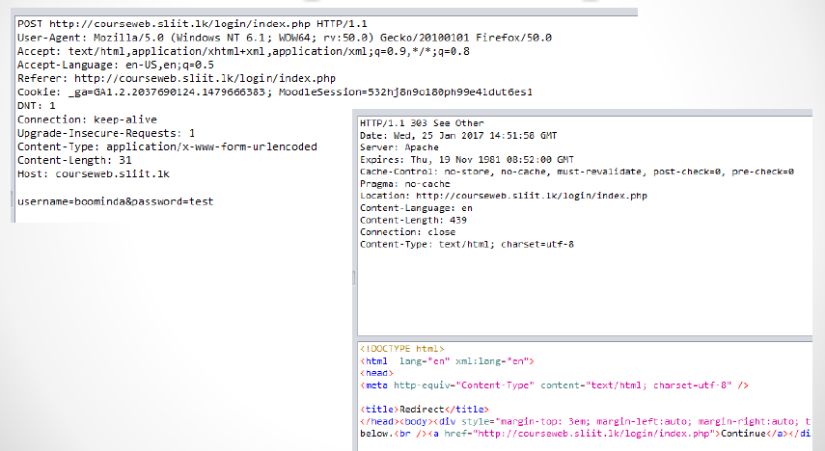

Slide 14
Four Popular Methods (further explanation)
Read-only method
GET
POST
Write Methods
PUT
DELETE

Slide 15
Security Issues in HTTP Methods
Idempotent Method and Non – Idempotent method
Non – Idempotent method
POST
GET
Idempotent methods
PUT
DELETE

Slide 16
Safe Methods
HEAD, GET, OPTIONS and TRACE are defined as safe
Intended only for information retrieval and should not change the state of the server.
However can use these methods to gather information about the server
Idempotent Methods
HTTP methods that can be called many times without different outcome
GET, HEAD, OPTIONS, PUT, DELETE methods
POST is not Idempotent

Slide 17
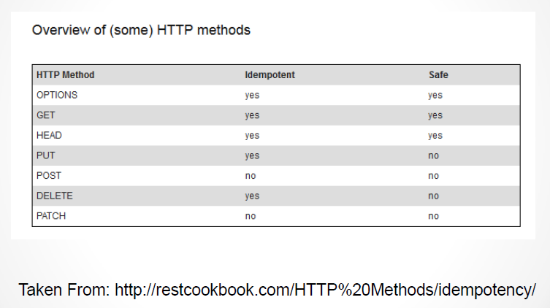
Security Issues in HTTP Methods

